Slide 1

ODI MATCHES RESULTS
Project by:
BHAVIN G CHENNUR
MONISH S
NISHANTH SHASTRY
November 27, 2019
1

Slide 2

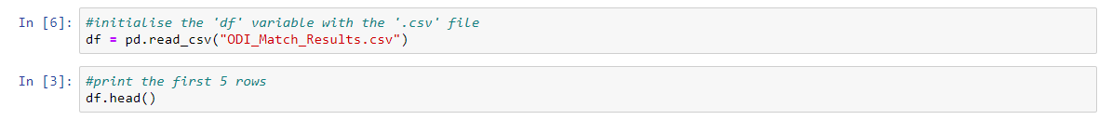
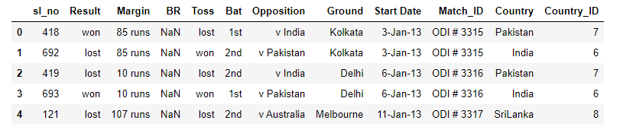
ODI MATCHES RESULTS
Dataset Description
1322 rows and 12 Columns
3 numerical columns and 9 categorical columns
About 5-6% of data is Missing values.
November 27, 2019
2

Slide 3
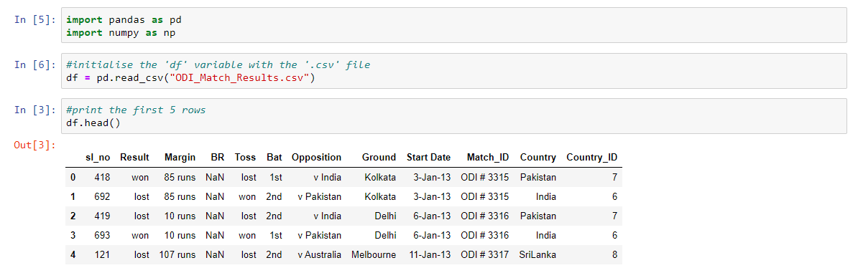
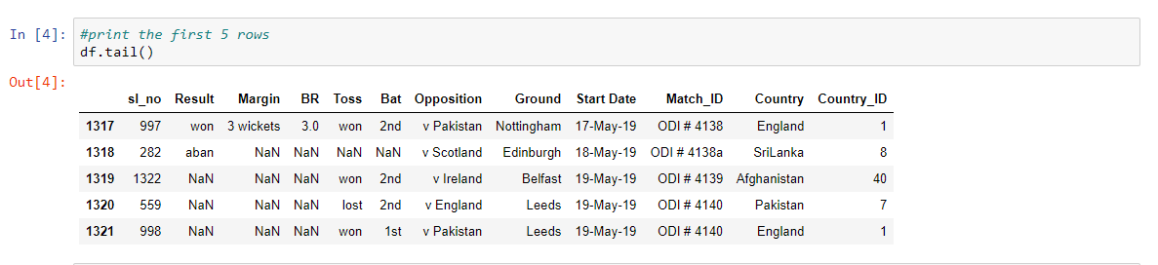

Slide 4
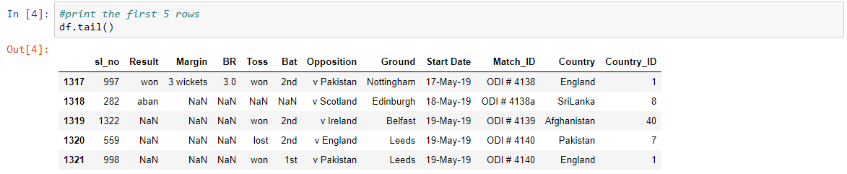
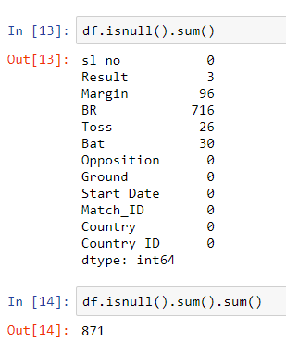

Slide 5
ODI MATCHES RESULTS
2. Data Cleaning
All the NAN’s for categorical columns to be replaced with its previous row values.
All the NAN’s for numeric columns to be replaced with average of the column.
November 27, 2019
5

Slide 6
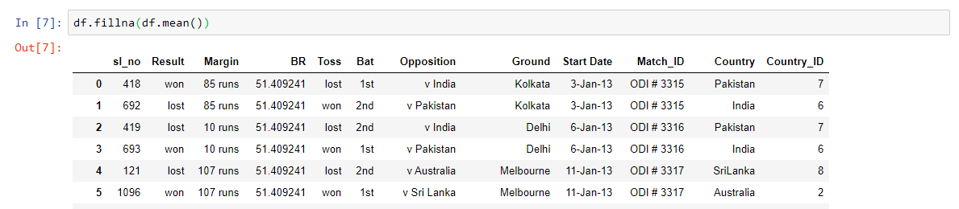
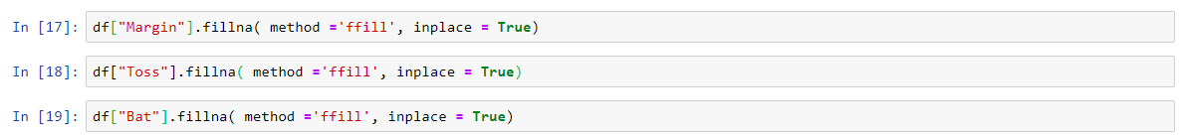
All the NAN’s for numeric columns are replaced with average of the column
All the NAN’s for categorical columns are replaced with its previous row values

Slide 7
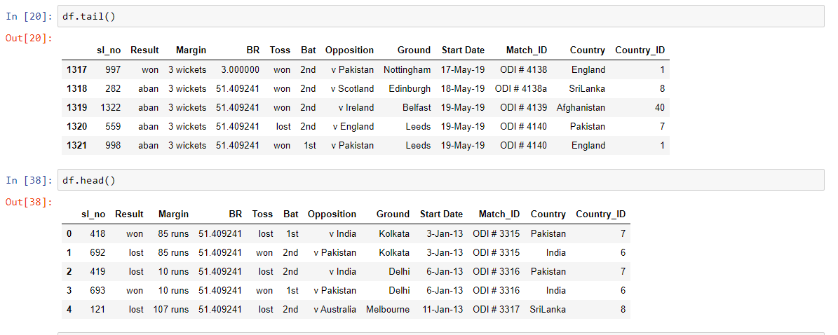
Dataset after Data Cleaning:

Slide 8
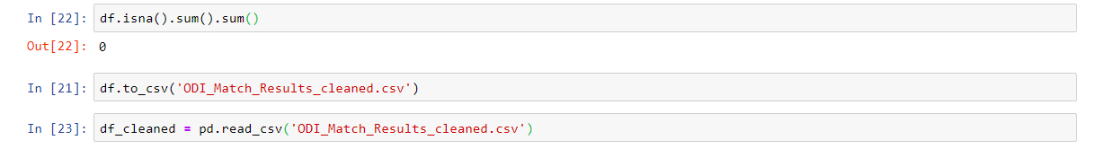
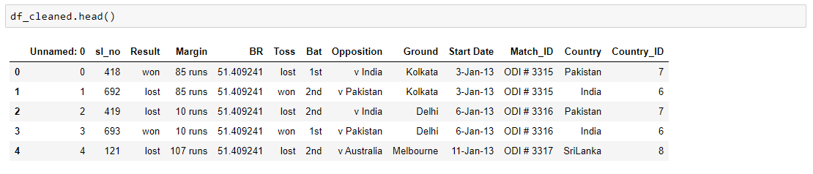
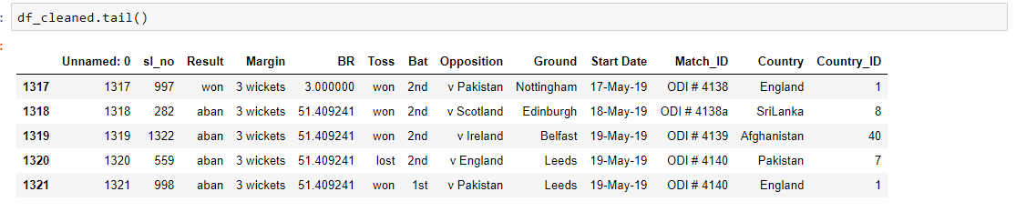
The dataset with modifications(i.e. after data cleaning) is stored in another .csv file for easier access in the later part of the project.

Slide 9
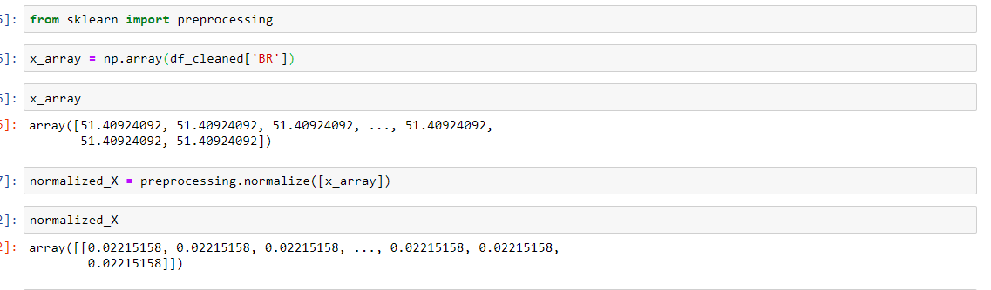
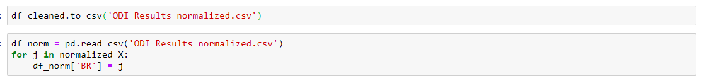
ODI MATCHES RESULTS
3. Normalization and Standardization:
November 27, 2019
9

Slide 10
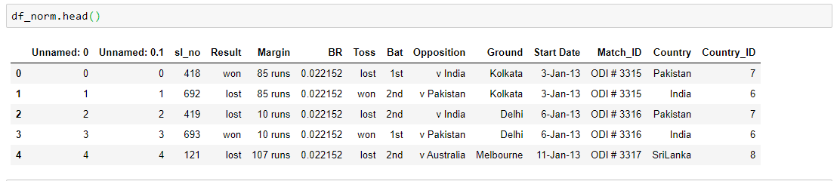
Dataset after normalization:-
The normalized values are stored in another .csv file for easier access of the normalized values for the later part of the project.
Dataset at the initial stage of the project

Slide 11
ODI MATCHES RESULTS
4. Graph visualization:
We have used the following data visualizations:
Bar chart:- To find the number of matches won by each country in all the matches played from 3-Jan-2013 to 19-May-2019
Stacked Bar Chart:- To represent the matches won by each country when they bat first and second(i.e. bat 1st and 2nd).
Histogram:- To represent Balls remaining for teams who won batting 2nd.
Scatterplot:- To represent correlation.
November 27, 2019
11

Slide 12
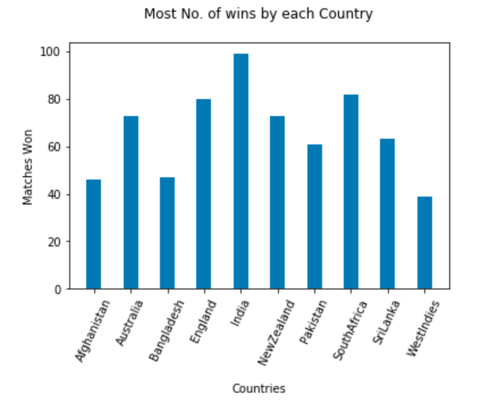
Bar chart:-
To find the number of matches won by each country in all the matches played from January 2013 - May 2019.

Slide 13
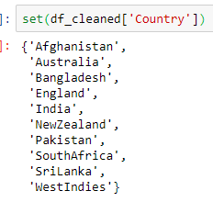
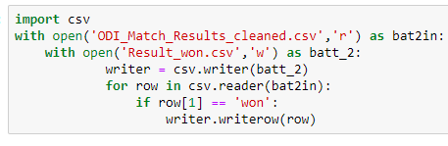
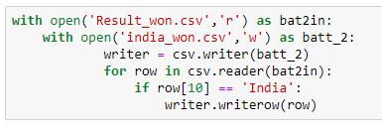
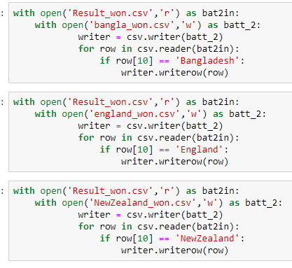
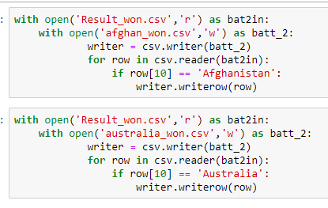

Slide 14
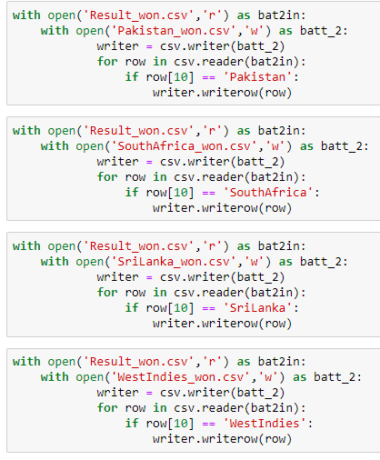
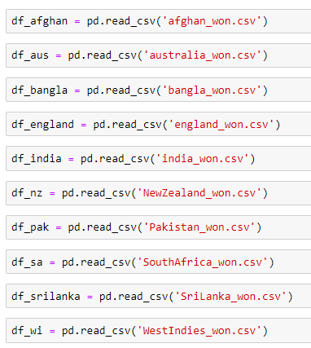

Slide 15
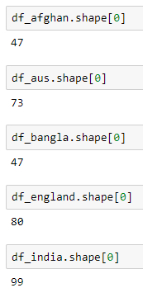
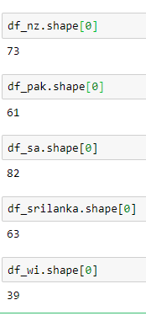
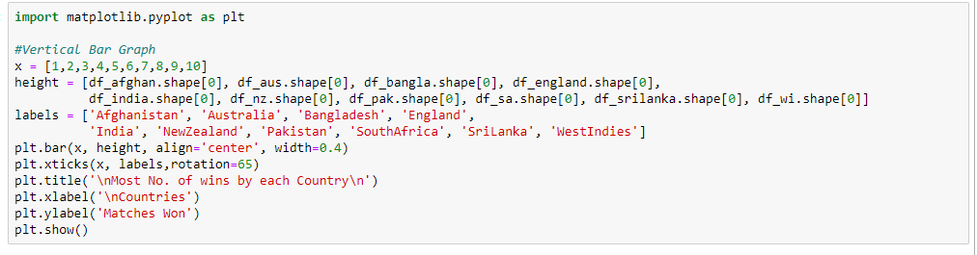
Initial steps to create the heights of the bars for the ten countries that are in our dataset.

Slide 16
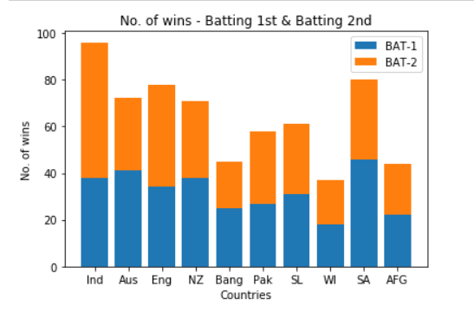
Stacked Bar Chart:-
To represent the matches won by each country when they bat first and second(i.e. bat 1st and 2nd).

Slide 17
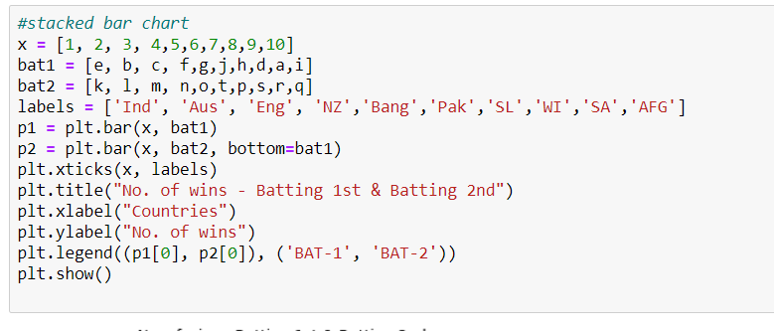
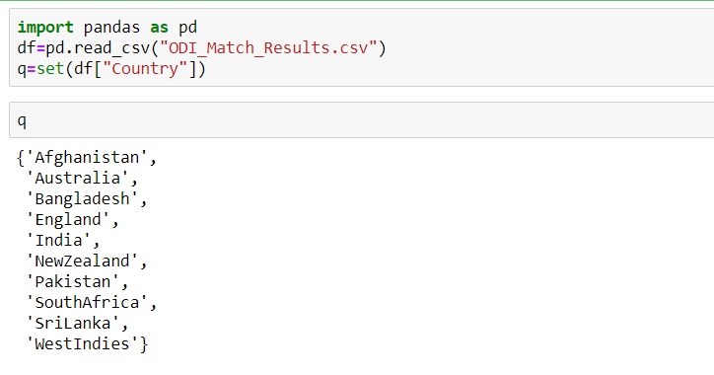

Slide 18
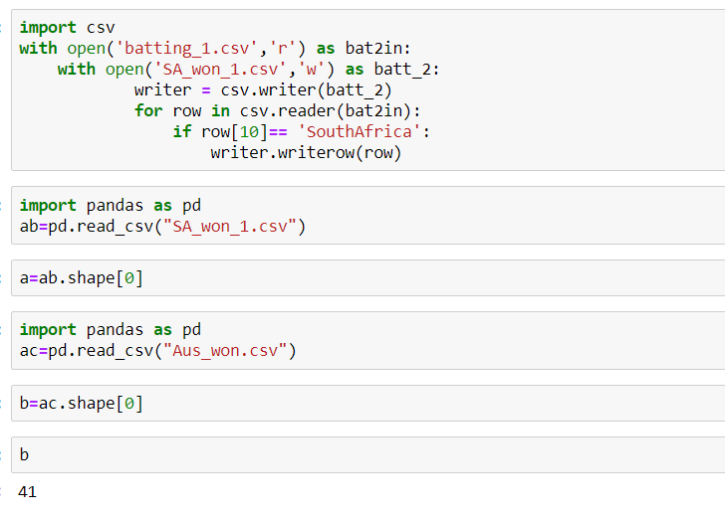

Slide 19
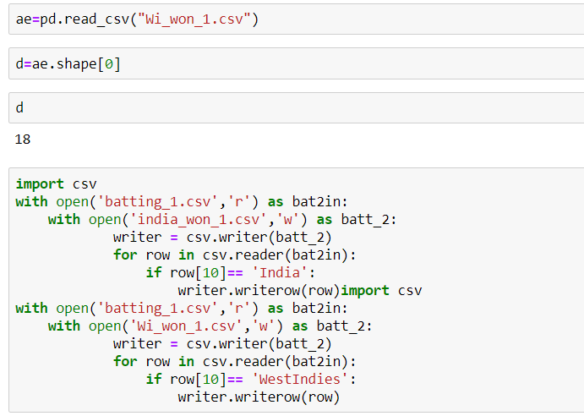
The above code is applied to all the ten teams in our dataset and is then used to plot the stacked bar chart

Slide 20
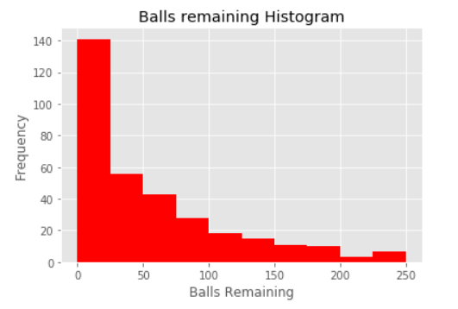
Histogram:-
To represent Balls remaining for teams who won batting 2nd.

Slide 21
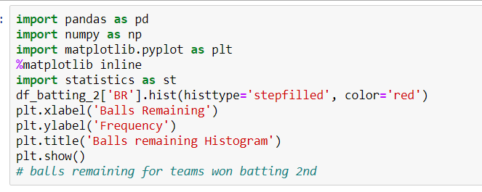
Simple code to create the Histogram of our requirement

Slide 22
ODI MATCHES RESULTS
5. Hypothesis Testing:
Hypothesis 1:-
Ho:- Population mean for BR variable in original dataset
is less than or equal to 51.93.
Ha:- Population mean for BR variable in original dataset
is greater than 51.93.
Result:- Failed to reject Ho.
Hypothesis 2:- (Teams who won the toss and batted 2nd)
Ho:- Teams who won the toss chose to bat 2nd assume to win the match considering dew factor with many balls to spare.
Ha:- Teams who won the toss chose to bat 2nd lost the match
with very few balls to spare.
Result:- Failed to reject Ho.
November 27, 2019
22

Slide 23
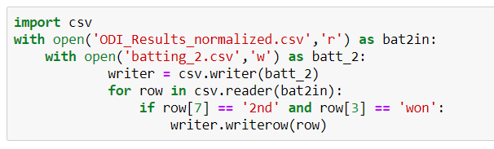
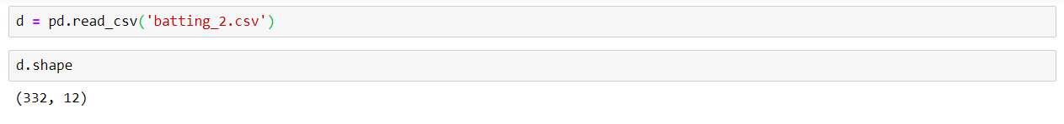
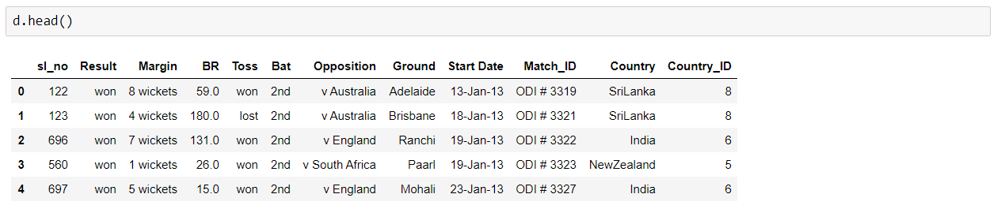
Initial steps for Hypothesis testing

Slide 24
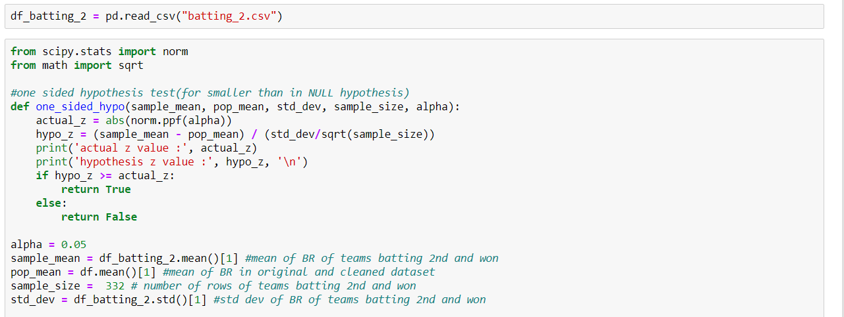
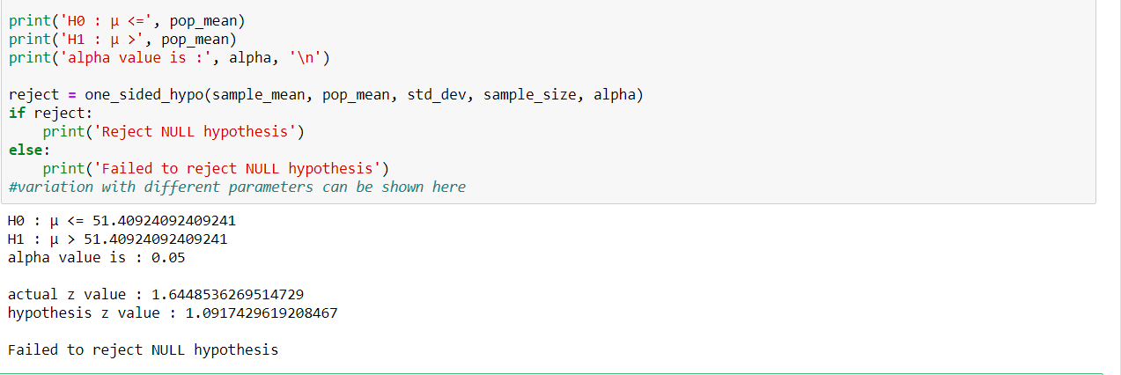

Slide 25
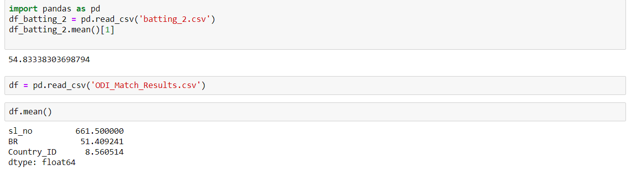
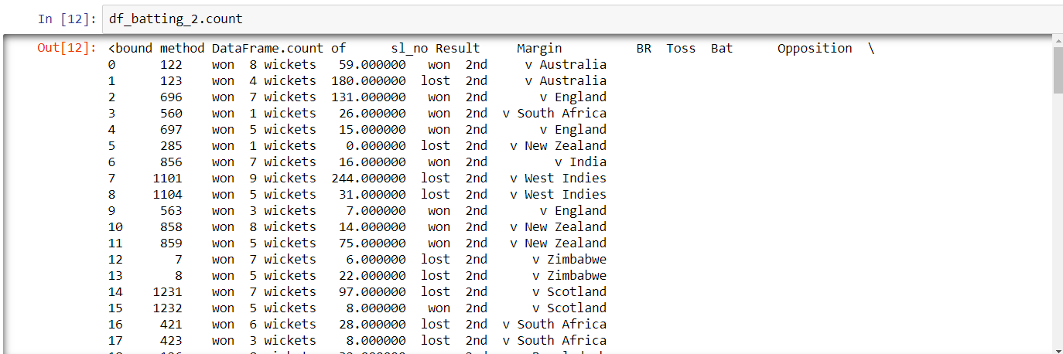

Slide 26
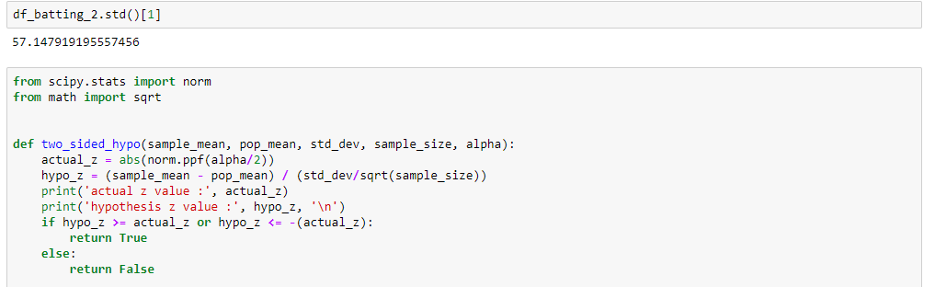
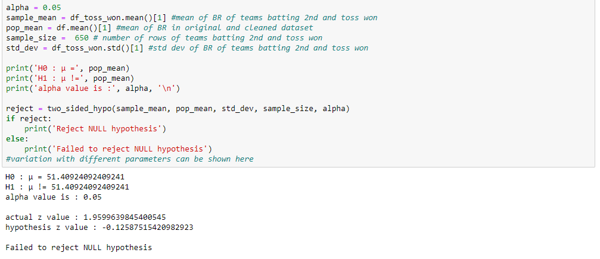

Slide 27
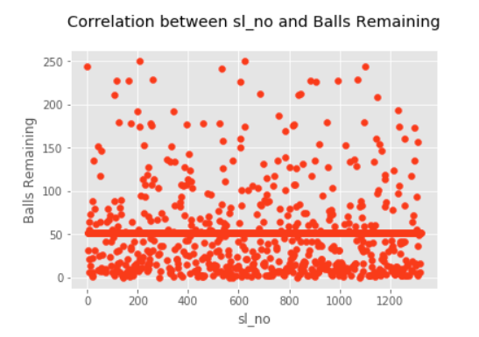
ODI MATCHES RESULTS
6. Correlation:
November 27, 2019
27

Slide 28
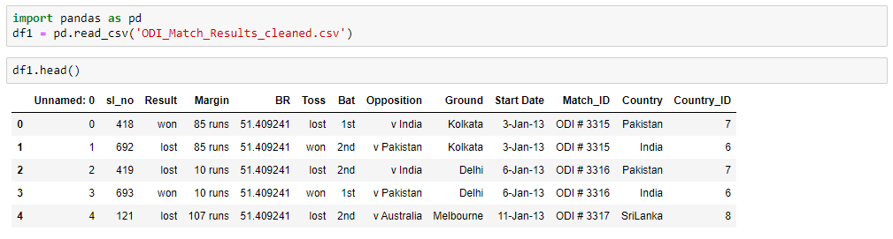
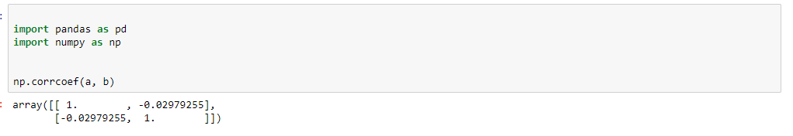

Slide 29
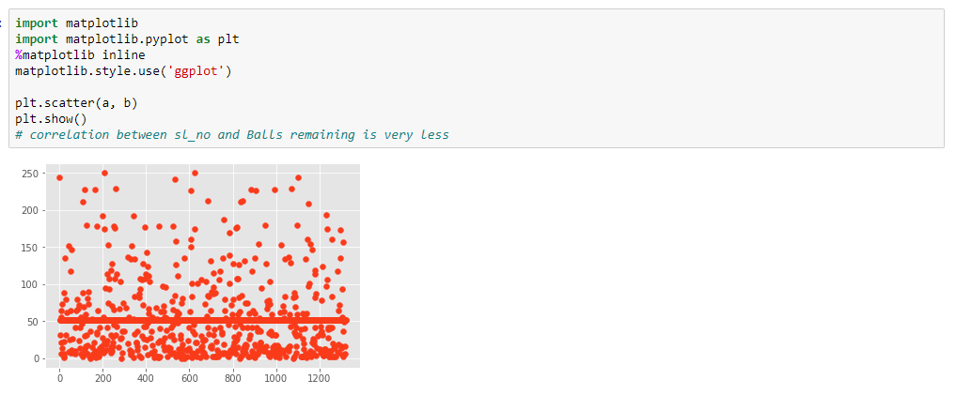
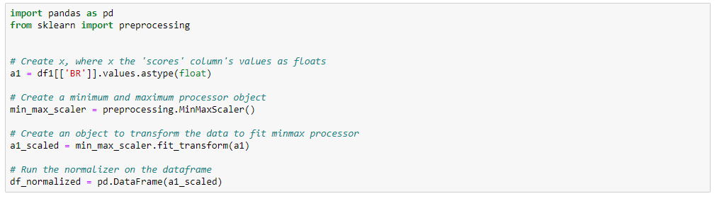

Slide 30
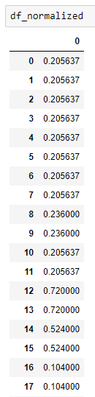
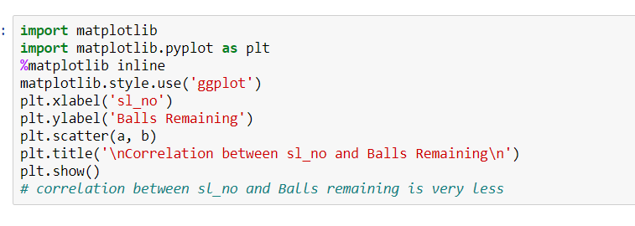

Slide 31
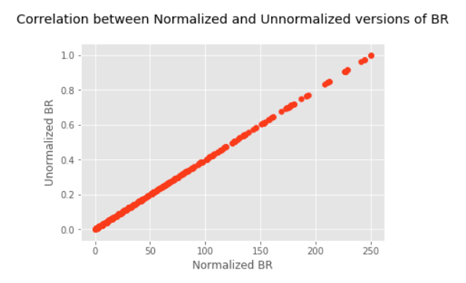
Correlation contd…

Slide 32


Slide 33
ODI MATCHES RESULTS
Open to Questions….
November 27, 2019
33

Slide 34
ODI MATCHES RESULTS
Thank you
November 27, 2019
34

